Slide 1
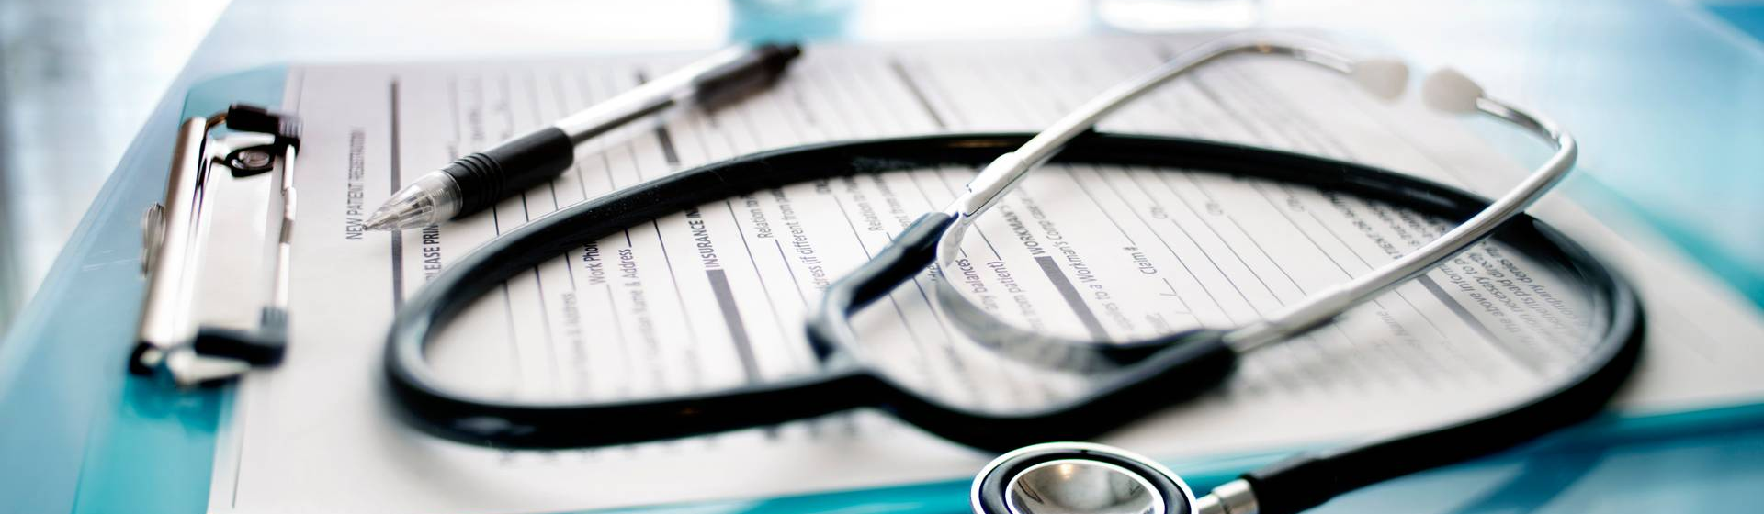
SKIN DISEASE DETECTION

Slide 2
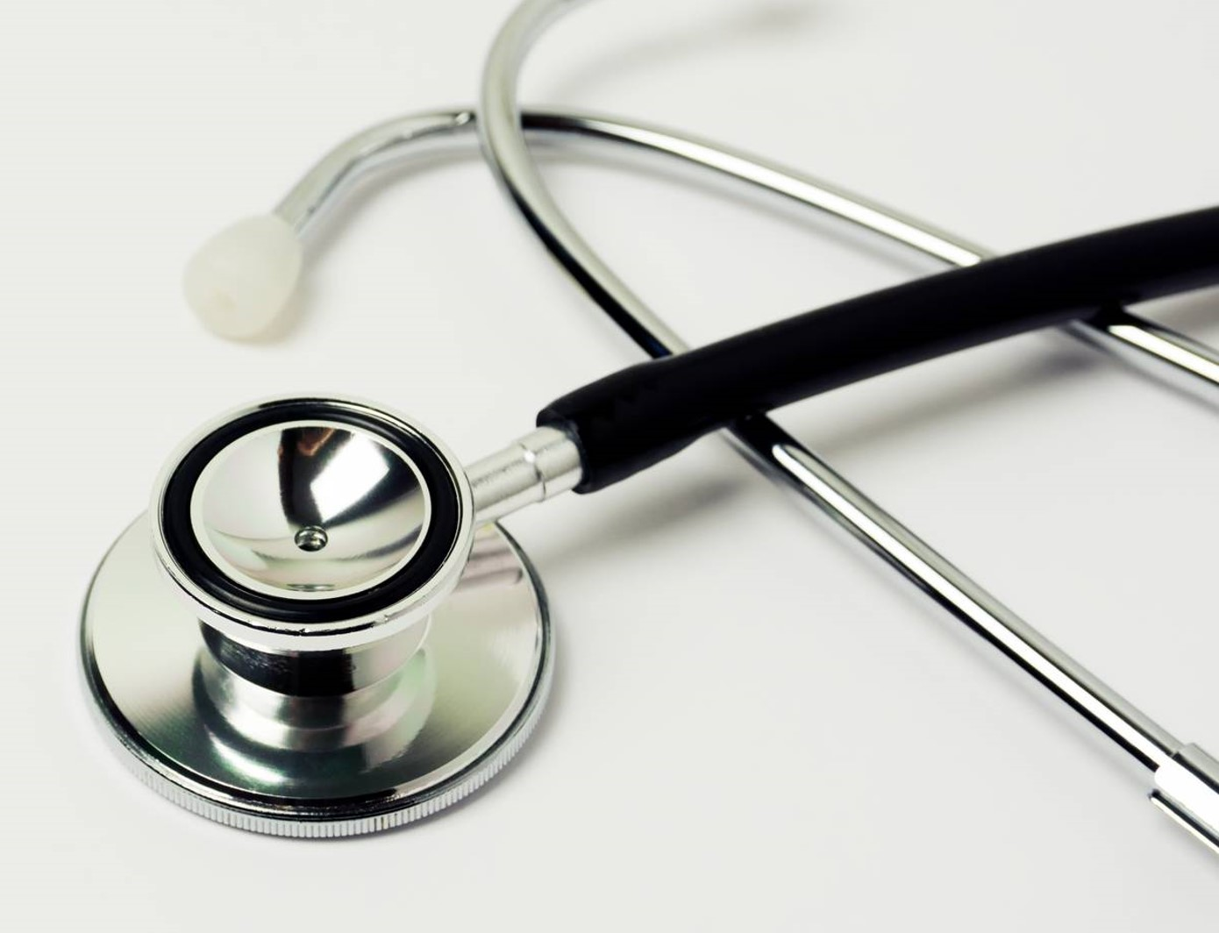
Agenda
Develop an AI-powered system that uses machine learning to detect skin diseases from images provided by users. The system will analyze the images, provide a description of the potential disease, offer recommendations for nearby dermatologists, and suggest if the disease requires isolation or special care measures.

Slide 3
INTRODUCTION
Skin diseases are among the most common health issues in Canada. According to the Canadian Dermatology Association, 1 in 3 Canadians will suffer from a skin condition at some point in their lives.
Common conditions include eczema, psoriasis, acne, and skin cancer.
Skin cancer is particularly concerning, with approximately 80,000 new cases diagnosed annually in Canada.

Slide 4

Dataset: https://www.kaggle.com/code/tanshihjen/nlp-task-skindiseasetextclassification

Slide 5
Overview of the System
User Interface: Allows users to upload images of their skin condition.
Image Preprocessing: Enhances image quality, removes noise, and standardizes images for analysis.
ML Model: Uses convolutional neural networks (CNNs) to analyze images and detect skin diseases.
Output: Provides a description of the potential disease, suggests nearby dermatologists, and recommends care measures.
Related paper: A Web-Based Skin Disease Diagnosis Using Convolutional Neural Networks -https://www.researchgate.net/publication/337171348_A_Web-Based_Skin_Disease_Diagnosis_Using_Convolutional_Neural_Networks

Slide 6
ADVANTAGES
Accessibility: Provides dermatological insights to users in remote or underserved areas.
Early Detection: Facilitates early diagnosis and treatment, improving patient outcomes.
Cost-Effective: Reduces the need for initial in-person consultations, saving time and money.
Scalability: Can be scaled to handle a large number of users with minimal additional cost.

Slide 7
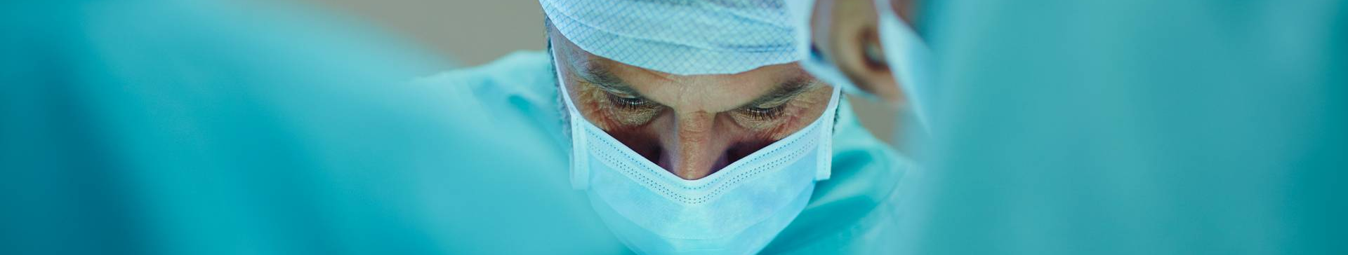
ML USE CASES
1. Early Detection of Skin Diseases
2. Monitoring Chronic Skin Conditions
3. Identifying Highly Contagious Skin Diseases

Slide 8
Early Detection of Skin Diseases
The system will analyze images of skin conditions (e.g., rashes, moles, lesions) to detect and diagnose potential skin diseases. It will provide a description of the detected condition and recommend dermatologists nearby. Enables early detection and treatment of skin diseases. Provides users with quick access to professional healthcare. Reduces the need for initial physical consultations.
Implementation:
Utilize CNNs such as EfficientNet or InceptionV3 trained on dermatology datasets to classify skin conditions. Eg: HAM10000 - https://www.kaggle.com/datasets/kmader/skin-cancer-mnist-ham10000
Generate a textual description of the detected condition using natural language processing (NLP) techniques.
Integrate services to suggest nearby dermatologists.

Slide 9
Monitoring Chronic Skin Conditions
The system will help patients with chronic skin conditions (e.g., eczema, psoriasis) monitor their condition by regularly analyzing images and providing feedback on disease progression or improvement. Assists in effective management of chronic skin conditions. Provides continuous monitoring and early intervention.
Implementation:
Implement models to track changes over time by comparing current and previous images.
Use NLP to generate detailed reports on the condition’s progression.
Recommend follow-up visits with dermatologists based on changes detected.

Slide 10
Identifying Highly Contagious Skin Diseases
The system will detect highly contagious skin diseases (e.g., impetigo, scabies) and provide guidance on necessary isolation measures and immediate medical consultation. Prevents the spread of contagious skin diseases. Ensures users take appropriate precautions and seek timely medical help. Reduces the risk of outbreaks in communities.
Implementation:
Train models on datasets of contagious skin diseases.
Use NLP to provide clear instructions on isolation and hygiene measures if a contagious disease is detected.
Highlight the urgency and recommend immediate consultation with dermatologists or primary care providers.

Slide 11
Challenges and Solutions
Data Privacy: Ensure user data is securely stored and complies with regulations (e.g., GDPR, HIPAA).
Model Accuracy: Continuous improvement through regular updates and retraining with new data.
User Engagement: Educate users on how to take clear and accurate images for better analysis.
Future Directions
Expanded Dataset: Incorporate more diverse images to improve model accuracy across different skin types.
Integration with Wearables: Connect with smart devices to monitor skin health continuously.
Real-Time Diagnosis: Develop a mobile app for instant analysis and feedback.

Slide 12
Literature Survey
AI-Powered Diagnosis of Skin Cancer: A Contemporary Review, Open Challenges and Future Research Directions, Publishes in 2023
AI-based methods, particularly machine learning and deep learning, offer promise in automating diagnosis processes, potentially reducing morbidity and mortality rates associated with skin cancer.
ALGORITHM AND TECHNIQUE
Machine learning models, SVM, Navies Bais, Models, Long Short-Term Memory ,Deep Belief Network , CNN, RNN, man-machine systems; skin cancer; skin neoplasms.
APPLICATIONS
AI healthcare for skin cancer diagnosis offers potential, but it must address prerequisites and biases.
Dermatologists should embrace AI as a complimentary tool while working to enhance lesion identification accuracy

Slide 13
Literature Survey
2. Artificial intelligence for skin cancer detection and classification for clinical environment: a systematic review, Published in 2024
Research identification, selection, eligibility, data extraction, and data synthesis. Descriptive Analysis.
This systematic review focuses on the detection, categorization, and assessment of skin cancer pictures in clinical settings.
APPLICATIONS
Artificial intelligence shows great promise for improving skin lesion detection, notably for melanoma. While advances in image processing and deep learning offer promise for real-time diagnostics, clinical validation and collaboration with healthcare experts are critical to ensuring efficacy and patient-centric care.

Slide 14
Literature Survey
3. A Study on the Application of Machine Learning and Deep Learning Techniques for Skin Cancer Detection, published in 2024
Skin cancer diagnosis relies on precise detection, which is sometimes hampered by invasive and time-consuming procedures. Leveraging AI, particularly Deep Learning (DL), has promise for effective categorization using neural network simulations.
This paper presents a hybrid deep learning model that combines VGG16 and ResNet50 to address class imbalances and improve classification performance, enhancing the potential for precise skin cancer diagnosis.
APPLICATIONS
The study demonstrated the effectiveness of various DL architectures, such as DenseNet121 and ResNet50, in skin cancer identification, achieving high accuracy and precision scores. However, while these models offer promising support to dermatologists, they are not substitutes for professional medical diagnoses, highlighting the need for ongoing research and enhancements to ensure reliability in real-world clinical settings.

Slide 15

Thank you

